Slide 1
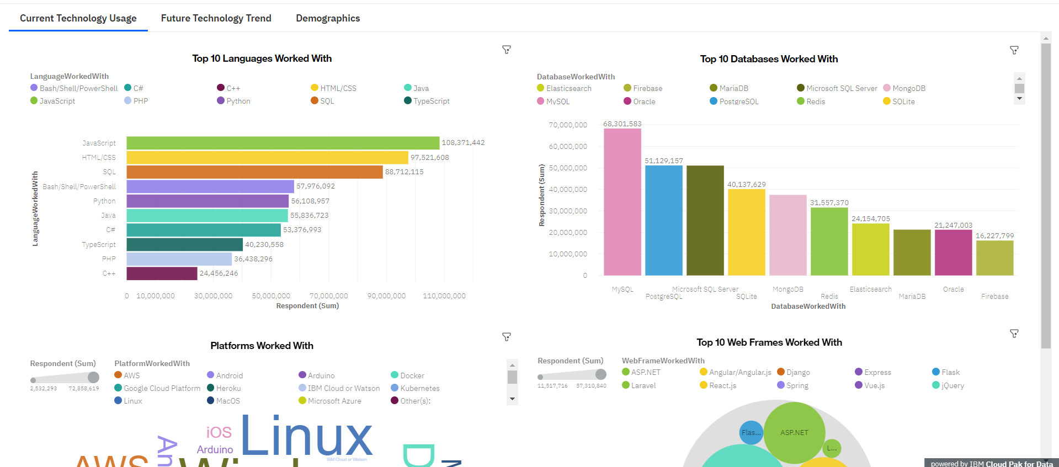

DASHBOARD TAB 1(Current Technology Usage)
Screenshot of dashboard tab 1 (Current Technology Usage):

Slide 2
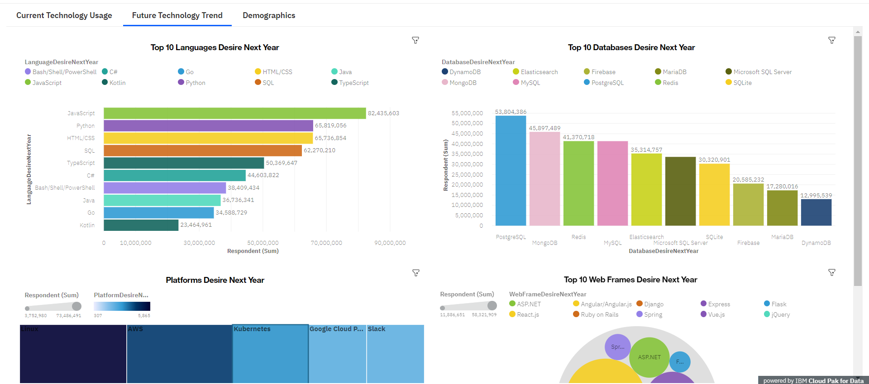
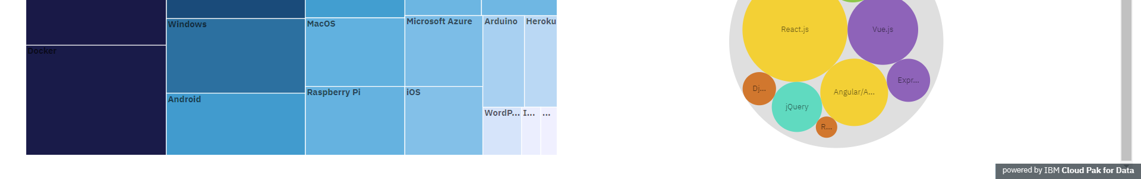
DASHBOARD TAB 2 (Future Technology Trend)
Screenshot of dashboard tab 2 (Future Technology Trend):

Slide 3
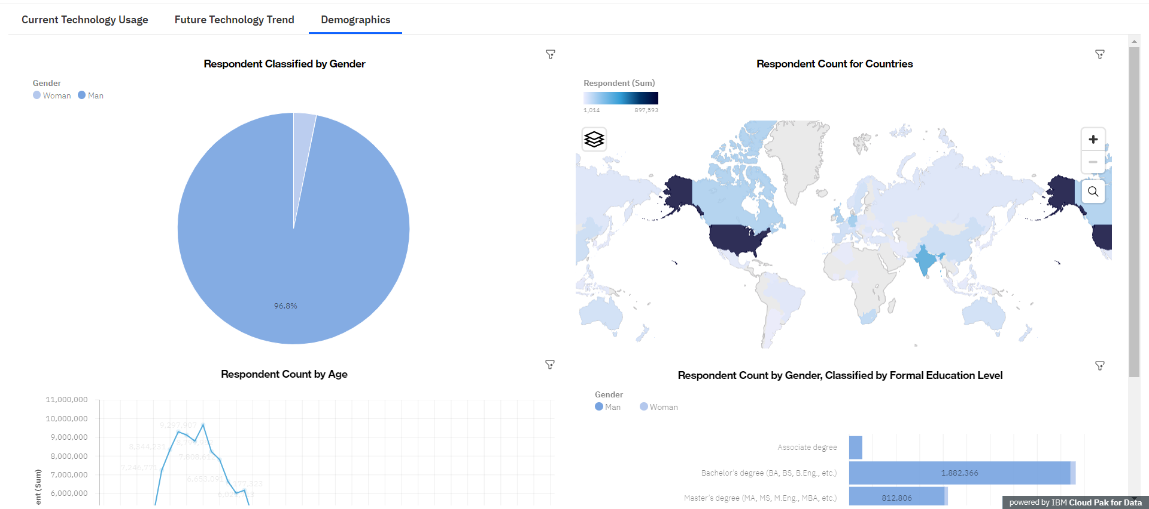
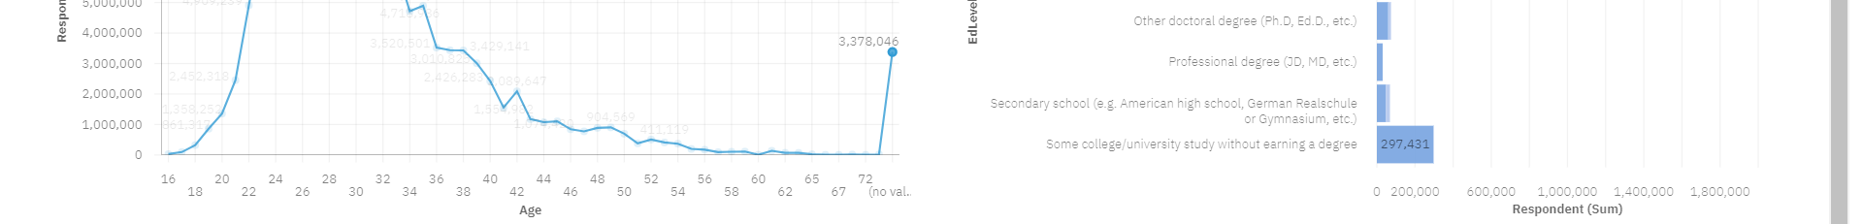
DASHBOARD TAB 3 (Demographics)
Screenshot of dashboard tab 3 (Demographics):

